Slide 1
Energy Imbalance of Estonian Prosumers
Energy Prosumers are indivisuals, Businesses or organizations that both consume and produce energy. This concept represents a shift from the traditional model where consumers simply purchase energy from utilities and rely on centralized power generation sources.
The energy imbalance problem indicates that there exists imbalance between production and consumption of energy. That is the generated electricity mismatches the demanding side(for example unexpected energy consumption behavior)
The goal of this project is to analyze energy consumption and production patterns of prosumers given the auxillary features like electricity, gas prices, installed solar panel capacity. This can be formulated as a Time series regression problem

Slide 2
Training Data
The Training data has the following fields namely
County – An ID code for the county
Is Business – Boolean flag for whether or not the prosumer is a business
Product type – ID code with the following mapping of codes to contract types(0 : “Combined”, 1 : “Fixed”, 2 : “General Service”, 3 : “Spot”)
Target – Consumption or Production amount for the relevant segment for the hour. The segments are defined by the county, is Business (Boolean Flag) and Product type
Is Consumption – Boolean for whether or not the row’s target is consumption or production
Datetime – The Estonian time in EET. The datetime is has hourly granularity

Slide 3
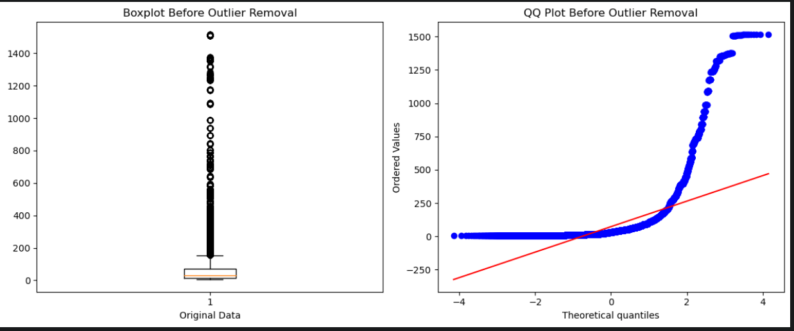
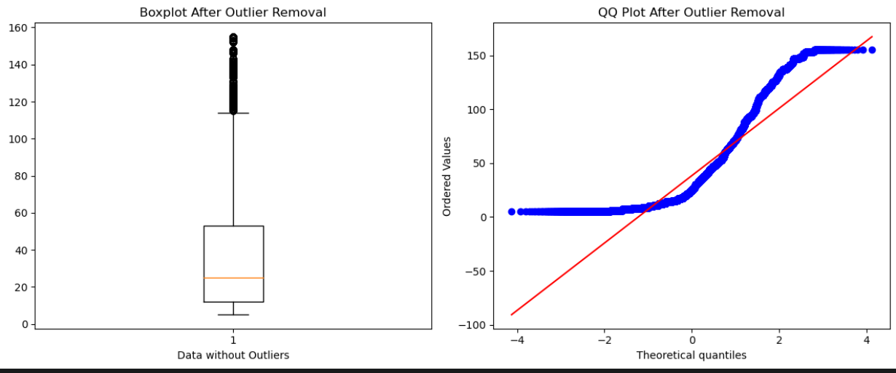
Outlier Correction
For Outlier correction I have used IQR Method
IQR = 3rd Quantile – 1st Quantile
Lower bound = 1st Quantile – 1.5* IQR
Upper bound = 3rd Quantile + 1.5* IQR
Any data point which is not in the range of
Lower and upper bound has been negated

Slide 4
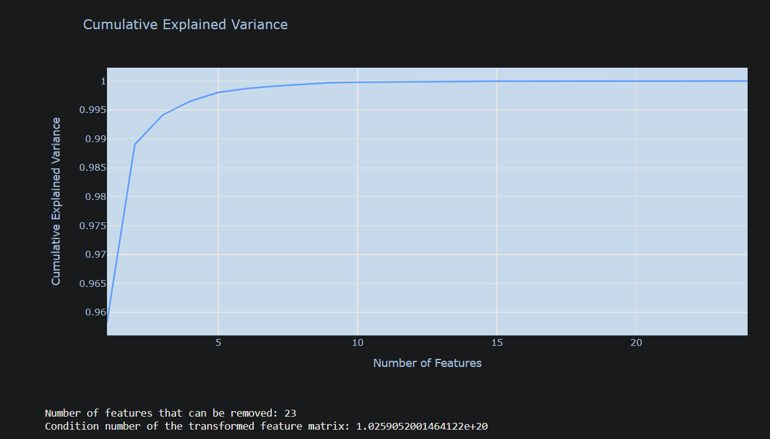
Principal Component Analysis
PCA is performed to reduce the dimensionality of the dataset while still retaining most of the important information. By transforming the original features into a new set of orthogonal variables called as principal components. Condition number signifies how well conditioned the covariance matrix of data is.
Low condition number – The spread of data along different dimensions is uniform
High condition number – This suggests that there is a significant difference in spread or variance along different dimesnions

Slide 5
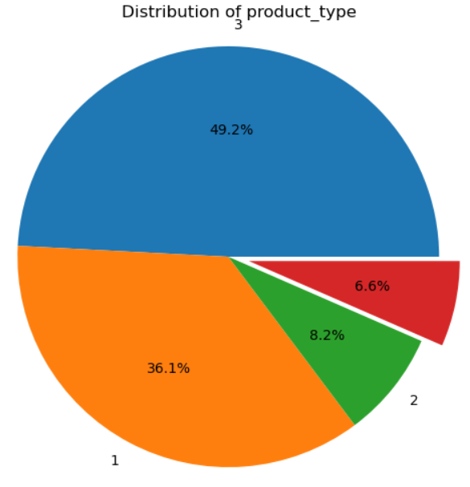
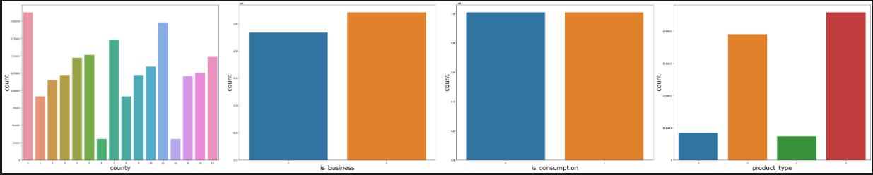
Segment Analysis
The Granularity of the train data is (datetime, county, is business flag and product type). All the predictions and analysis is done using this granularity as the base

Slide 6
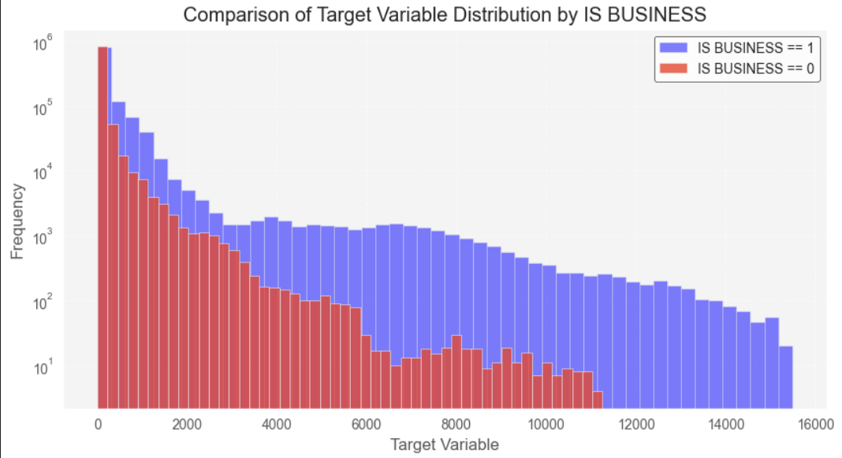
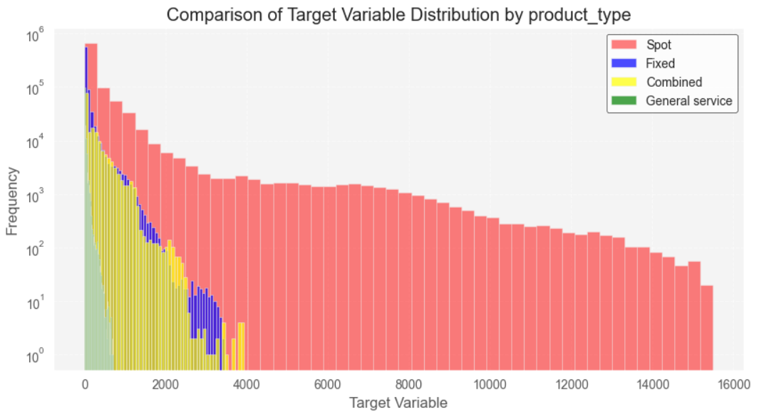
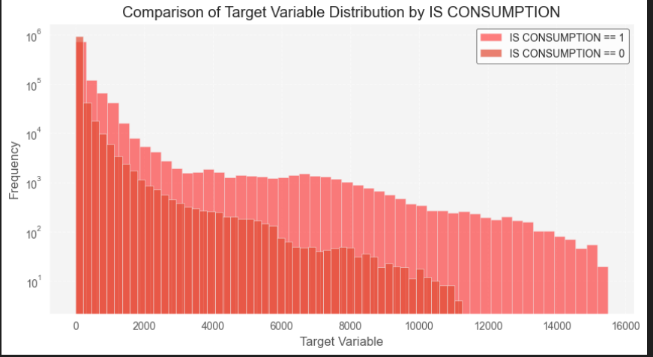
Target Analysis
The consumption or production amount for the relevant segment for the hour. The segments are defined by the county, is_business and product type.
Ana

Slide 7
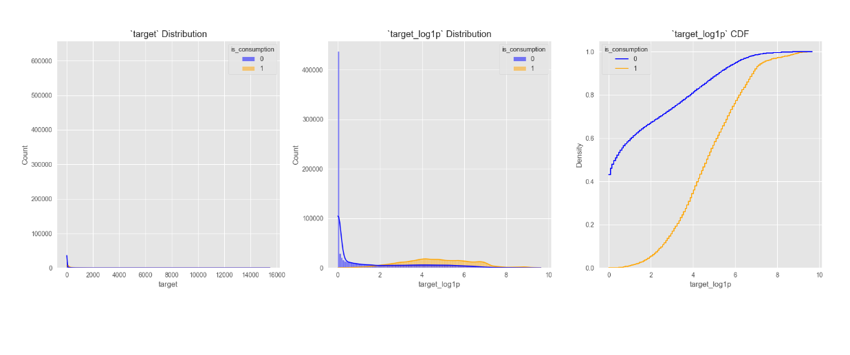
Analyzing the Target distribution.The most salient characteristic is the skewness of electricity production. Its very hard to get insight from leftmost plot so log transformation was performed to combat skewness. From the rightmost plot there is a sudden jump in the CDF plot of electricity production

Slide 8
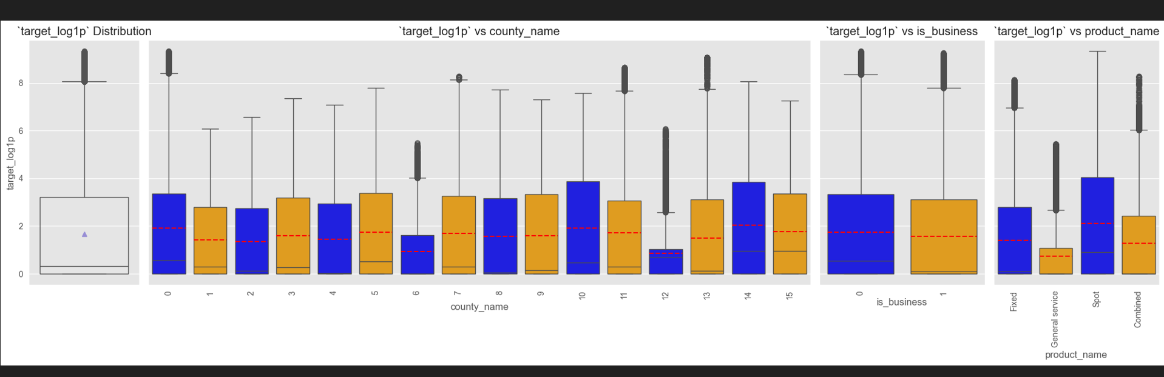
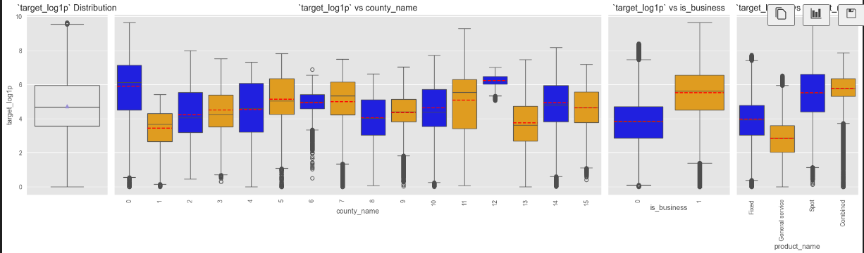
The first graph is when consumption flag is 0, county 0 and county 10 have a wider spread of electricity production as compared to other counties
Different product types show different characteristics
Second graph is when consumption flag is 1, Prosumers who are into business show a different behavior when compared across the target variable

Slide 9
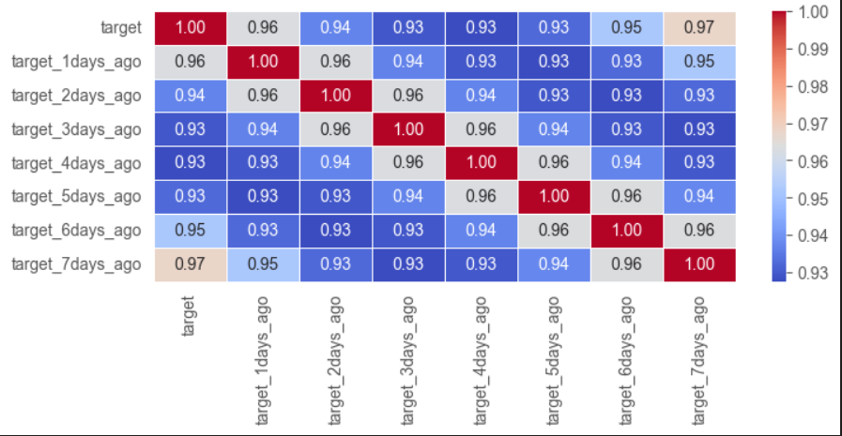
Lag analysis of Target
Lag analysis in Time series is performed to investigate the relationship between a variable and its past values over time. It involves creating lagged versions of the time series data and examining how these lagged values correlate with current values

Slide 10
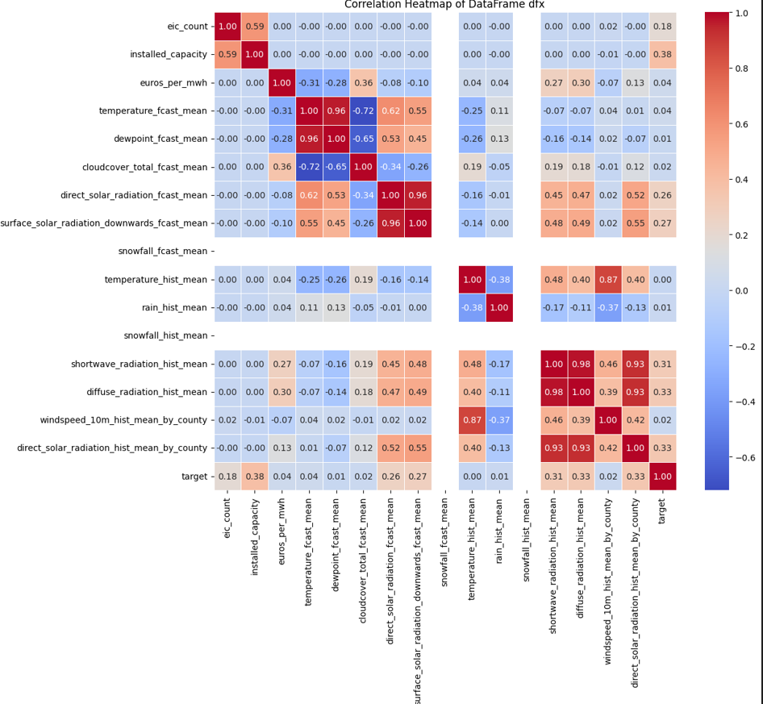

Slide 11
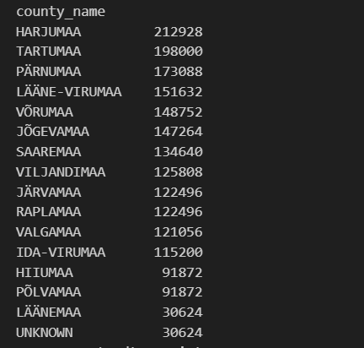
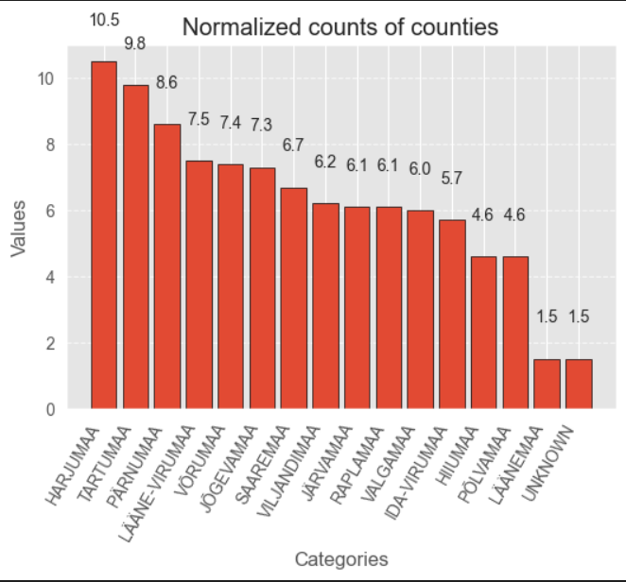
County Analysis
Total number of intersections in the dataset are 2018352. Mapped the county numbers with corresponding names through a Json file

Slide 12
Consumption-Production Analysis
Resampling the data to monthly, weekly and daily levels
Consumption is for the intersections where the “is_consumption” flag is set as 1
Production is for intersections where the “is_consumption” flag is set as 0

Slide 13
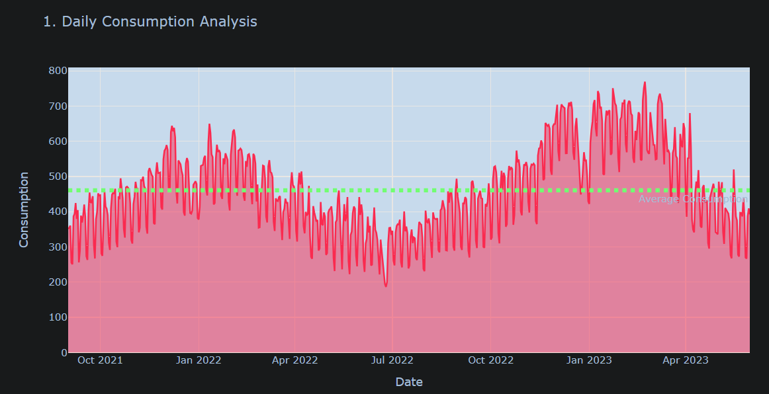
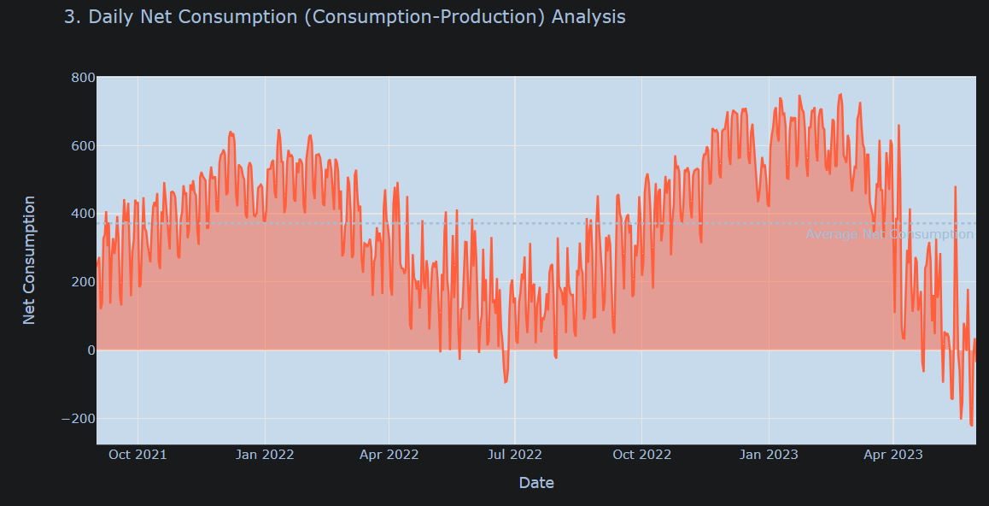
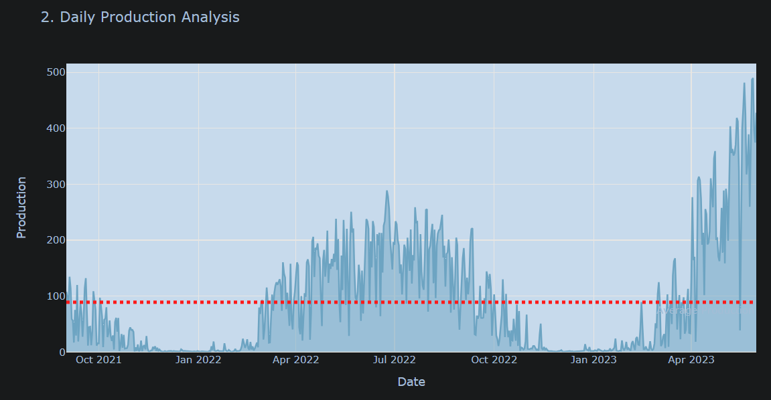
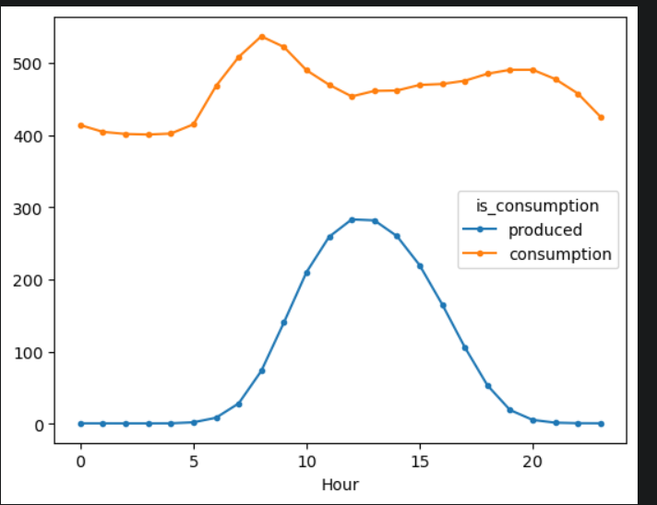

Slide 14
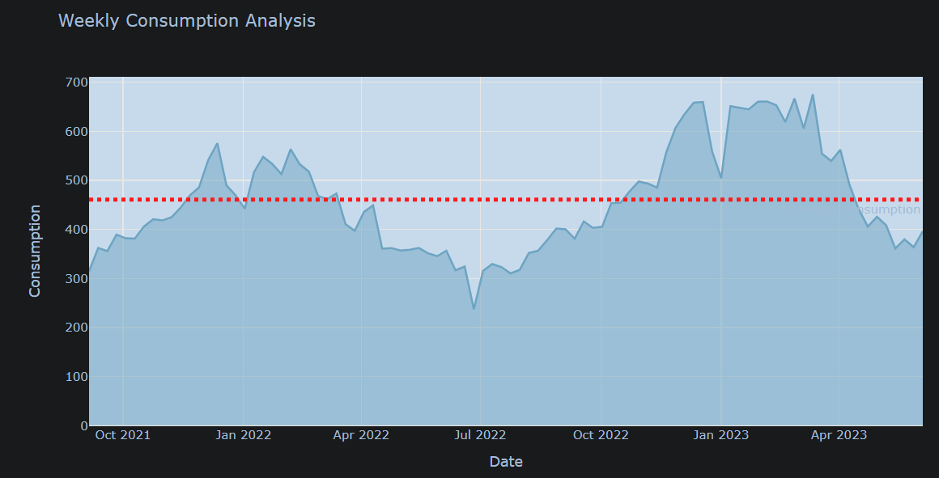
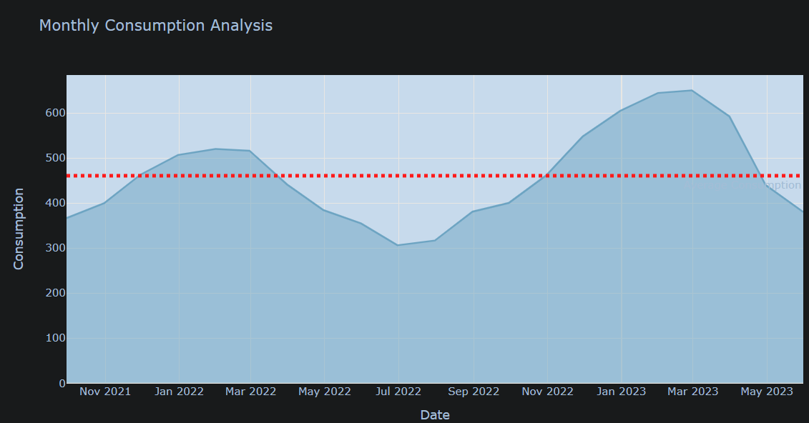
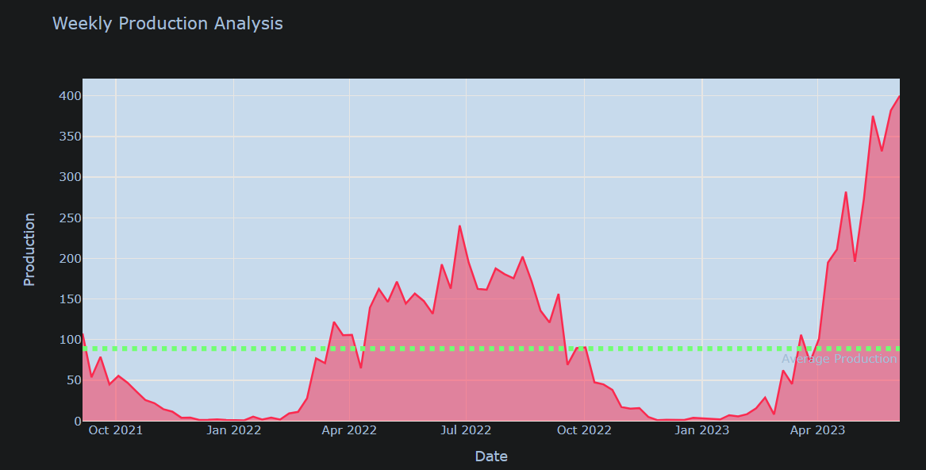
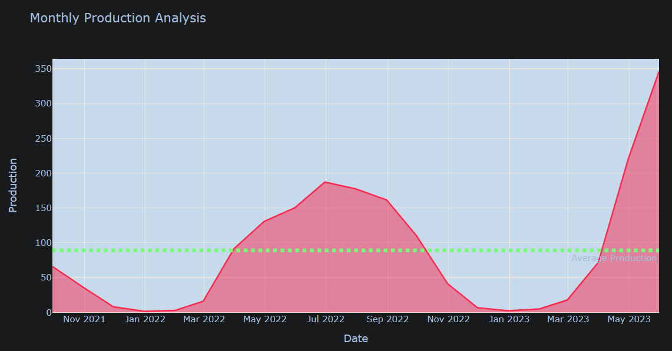

Slide 15
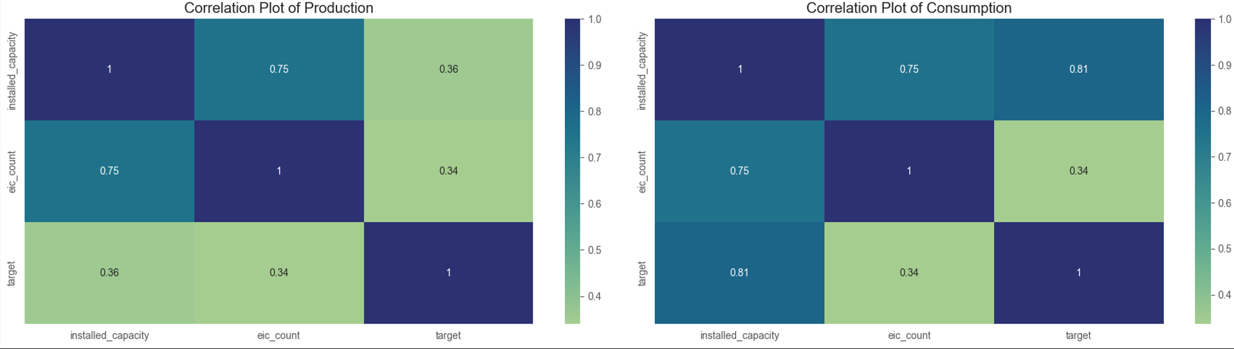
Exploring Client data
The client data has the following fields namely prediction unit id(UID)
Product types
EIC Count – Aggregated number of consumption points(EIC – European identifier code)
Installed capacity – Installed photo voltaic solar panel capacity in Kilowatts
Is business – Boolean flag : Whether or not the prosumer is a business or not
Inference - Installed capacity is highly correlated with target and there is a strong correlation between eic count and installed capacity

Slide 16
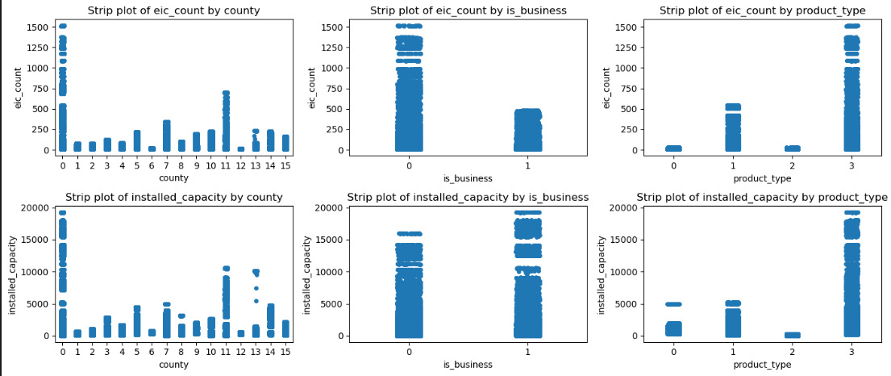

Slide 17
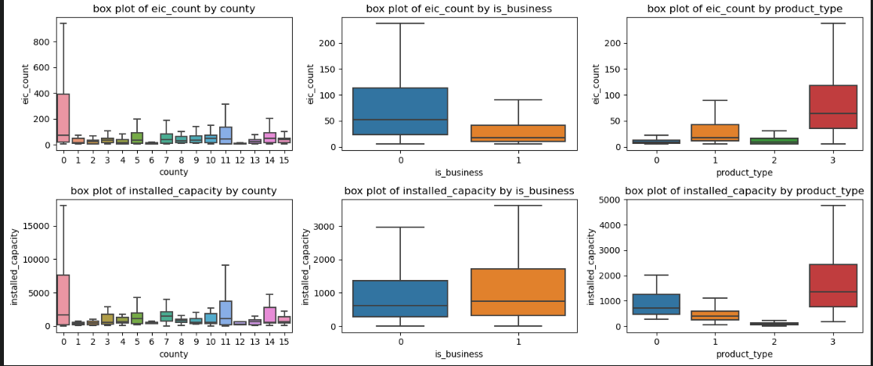

Slide 18
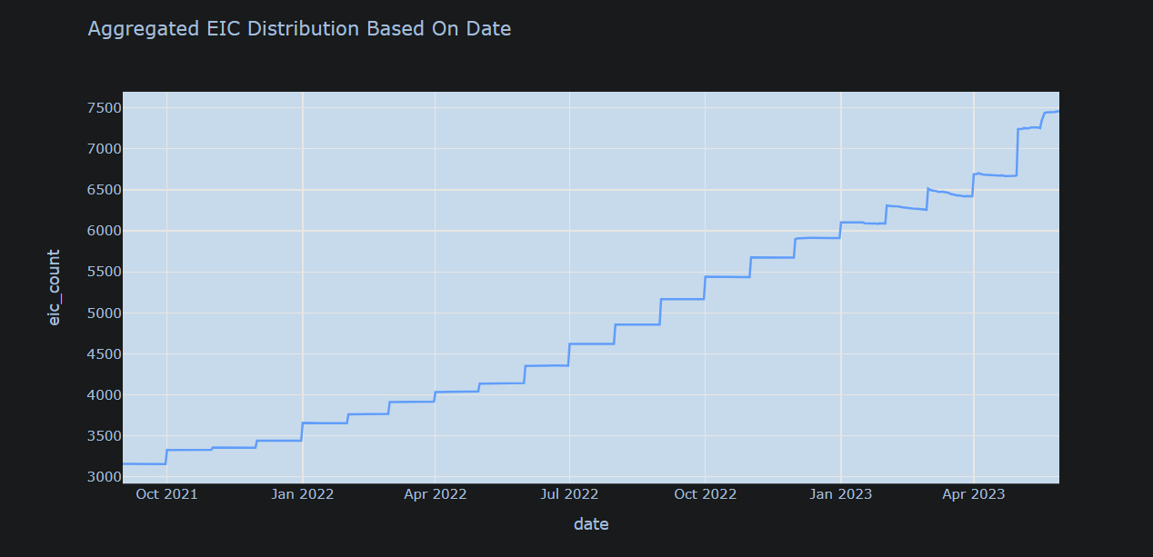
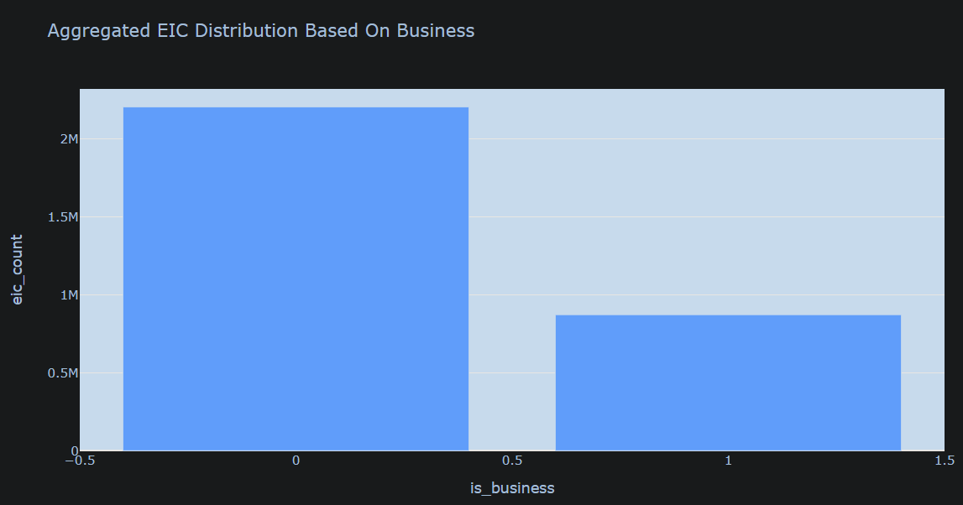
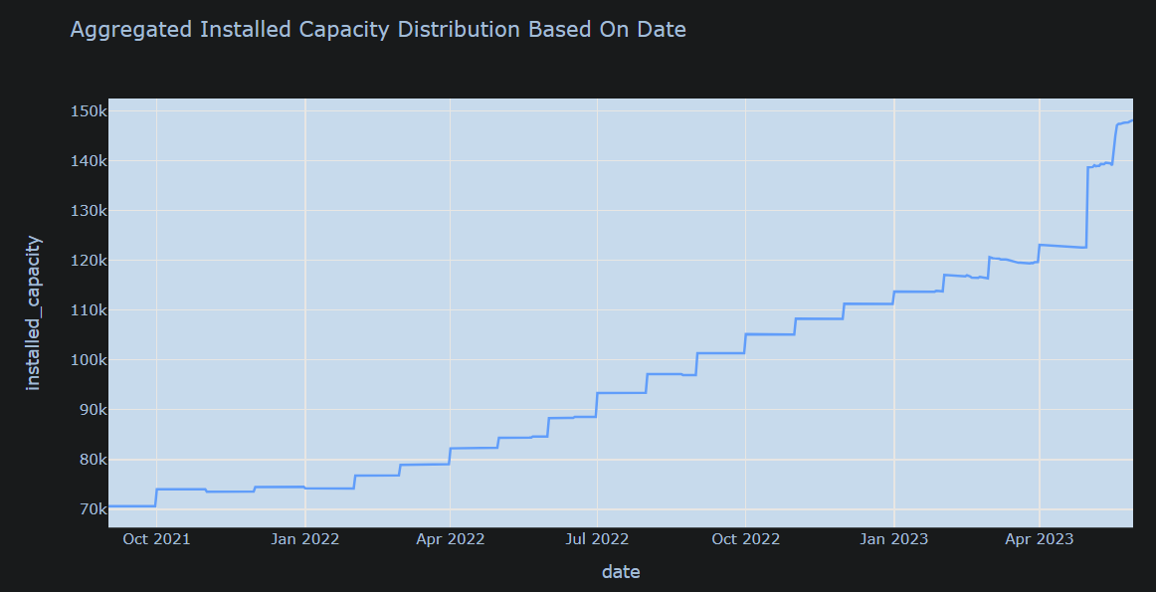
The Aggregated number of consumption points and installed capacity of solar panels is increasing over the datetime and the consumption for prosumer into business is less than prosumer who is not ino business

Slide 19
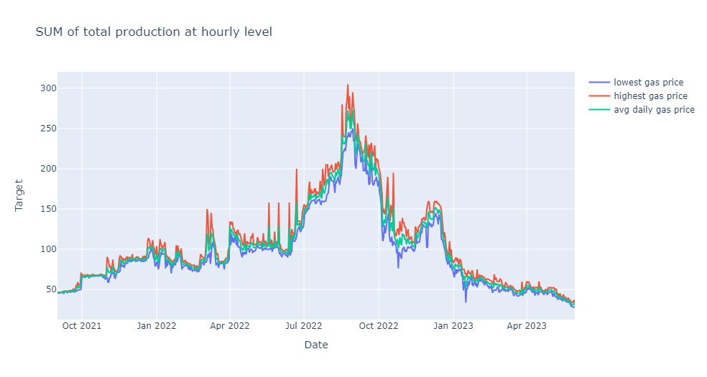
Gas Price Analysis
Gas Price data has the following fields namely block id
Lowest Price of natural gas per Mega Watt Hour
Highest Price of natural gas per Mega watt Hour
Origin date

Slide 20
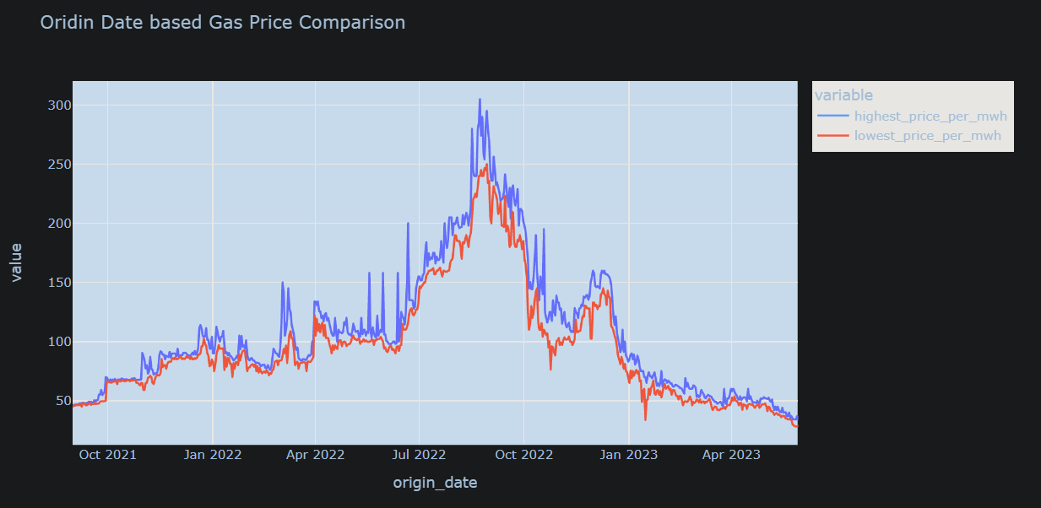
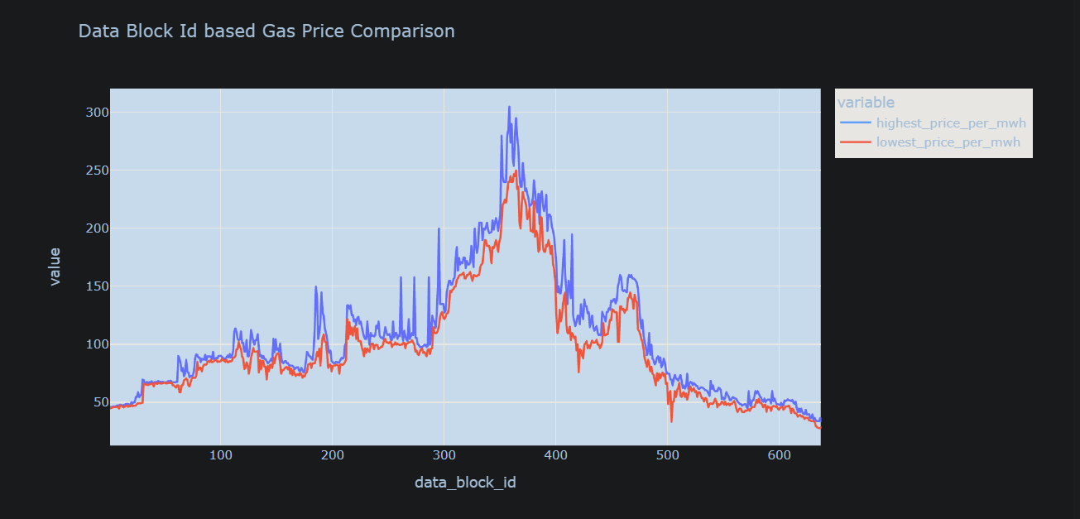

Slide 21
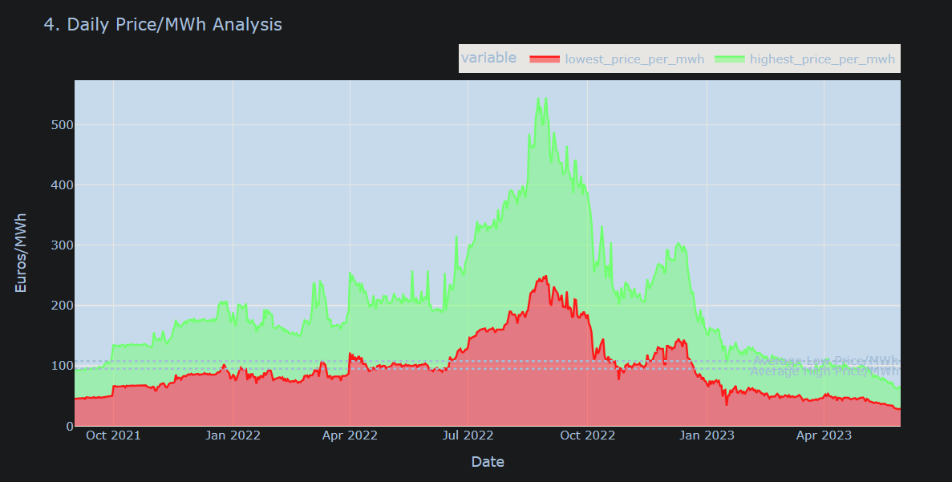
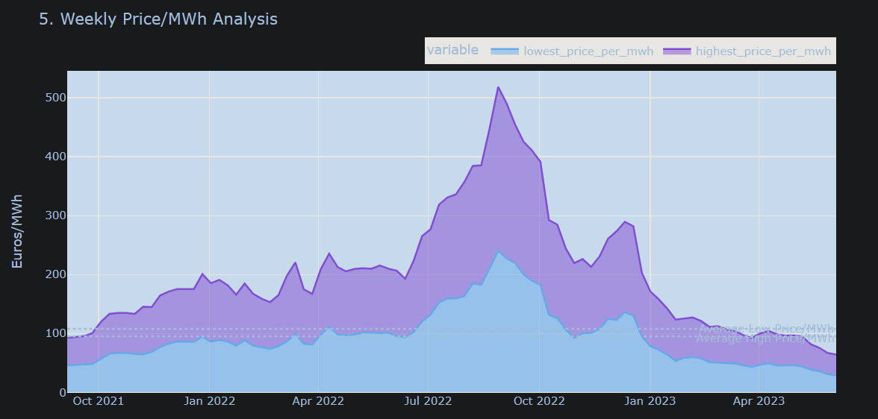

Slide 22
Weather Analysis
Weather dataset has the following fields
Rain – Rain amount from large scale weather systems in millimeters
Temperature
Dewpoint
Snowfall – Snowfall amount in millimeters
Surface pressure – Air pressure at surface in hectopascals
Windspeed – windspeed at 10 meters above the ground
Shortwave radiation – Global horizontal irradiation in watt hours per square meter
Diffusion radiation – The diffuse radiation in watts hours per square meter

Slide 23
